Slide 1

Week 04 – Collaborative Working
The sprint… IS OFFICIALLY ON (I think).
Notes:
Hello everyone. Welcome to week 4. We have fewer things to discuss, so this will take about an hour. Maybe a bit less or more… Next slide please.

Slide 2
How was everyone’s week?
Discuss!
Notes:
How was everyone’s week? What did you do?
(When everyone is finished) Next slide please.

Slide 3

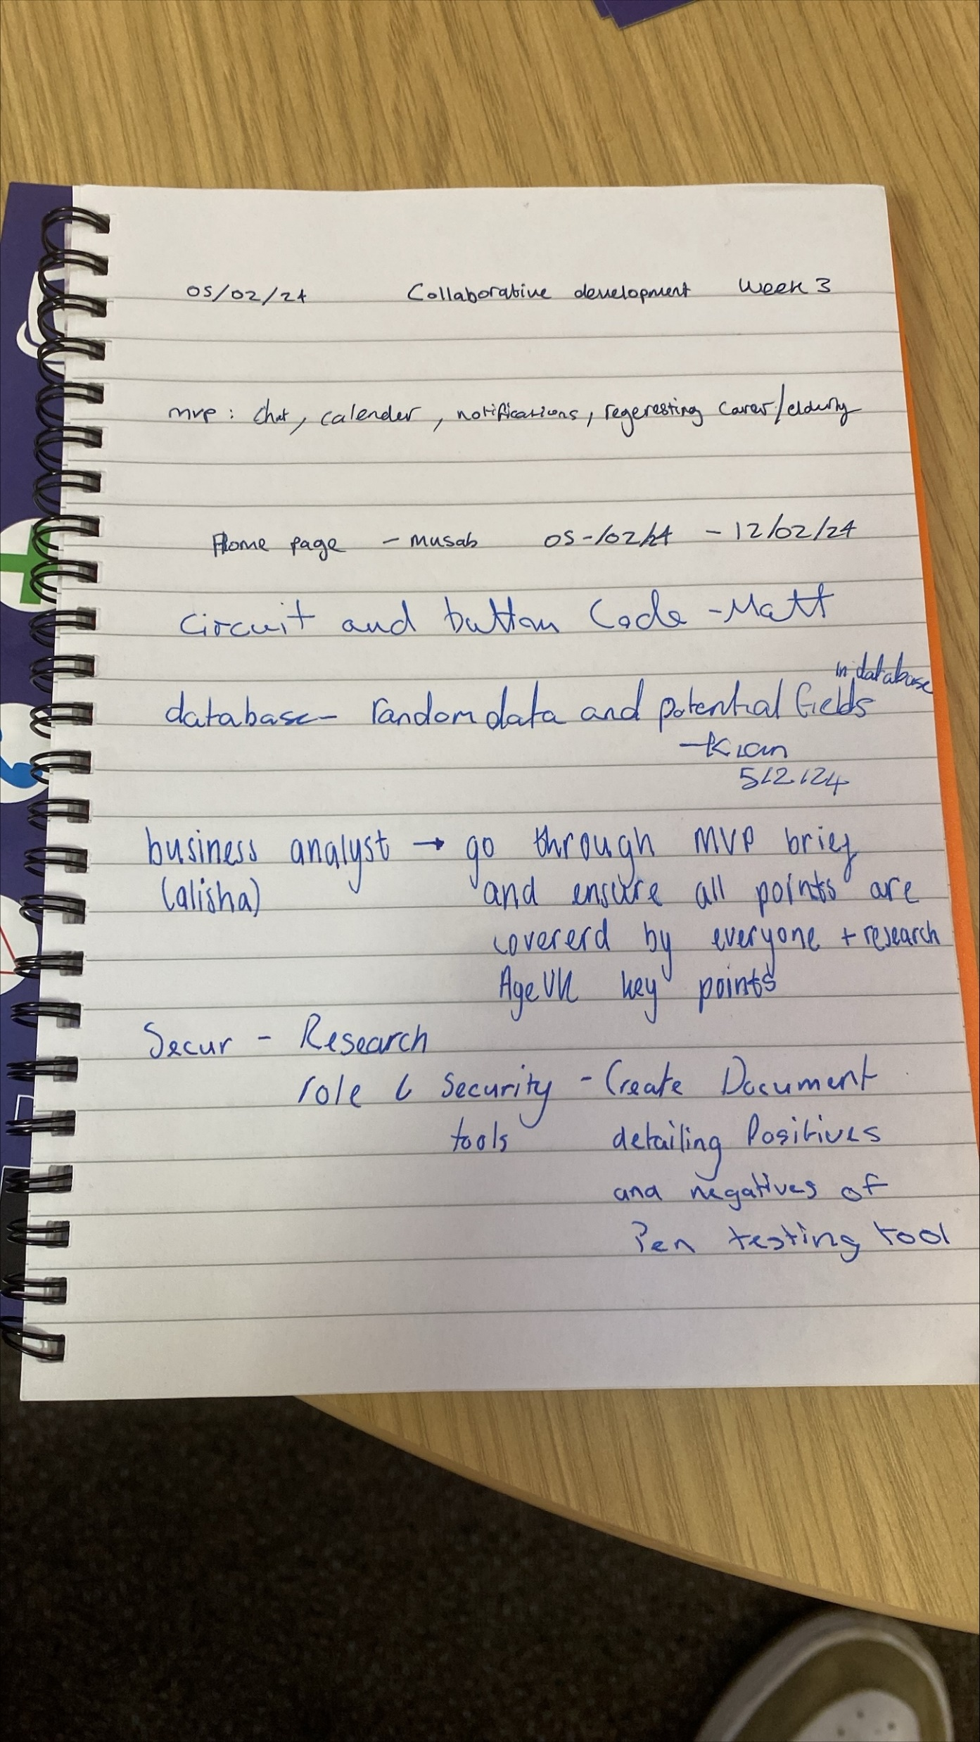
Last week…
Physical folders > Digital folders
QR code scan?
Issues with MySQL
Showed how to use GitHub
To-Do tasks (so we have something to discuss Thursdays)
Logo established (Tuesday by me)
MVP: Chat, Calendar, Notifications, Register and Login
Notes:
In the last week’s discussion, we talked about the physical folders going into a digital format, the possibility of QR codes to login, the issues with MySQL, I showed you all how to use GitHub on teams, tasks, the logo designed by me Tuesday, and the MVP; which was the chat system, a calendar, the notifications system, and the registration and login pages. Is everyone fine with that?
(When everyone says their parts) Next slide please.

Slide 4
Thursday’s meeting
Luke has been researching lots
Matt has been looking into extensions within Python (found anything?)
Musab has been doing the homepage (will hopefully show us today (if he hasn’t already)), as well as the registration and login pages
Kian did databases last semester, mapping out the databases
Feel like we can do the MVP if we do two tasks every week
University’s Wi-Fi broken
Notes:
In Thursday’s meeting, Luke had been researching a lot and enjoying it too. Matt had been looking into extensions within Python. Musab had been doing the homepage, as well as the registration and login pages. And Kian was mapping out the databases. We felt like we can do the MVP if we do two tasks every week, and we discussed the university’s Wi-Fi being broken. Has everyone completed their respective tasks?
(When everyone says their parts) alright, next slide please.

Slide 5
Tasks?
Discuss!
Notes:
What tasks does everyone want to do?

Slide 6
Seems like we’re ahead…
Notes:
If we take last week’s group task, we’re way ahead of everyone. Like it’s not even close. We got the funnel out the first meeting, meanwhile the group task was making the funnel. And other things as well. That’s if we take the last week’s task seriously. Some groups might have had their funnels out in the same week. So, let’s not get ahead of ourselves. Let’s just work as normal, and go from there. Next slide please.

Slide 7
Any Questions?
Seriously, if you guys don’t step in and interject, then I will keep using this gif.
Notes:
Any questions?

